Slide 1
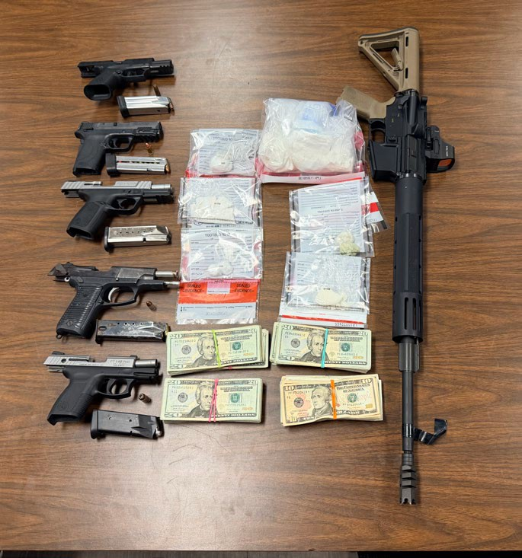
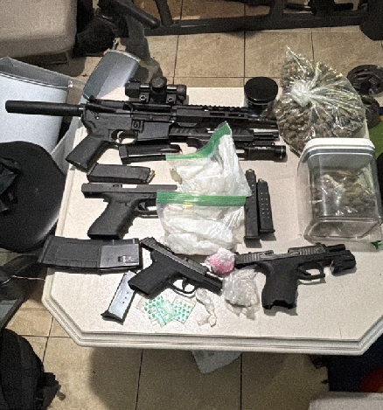
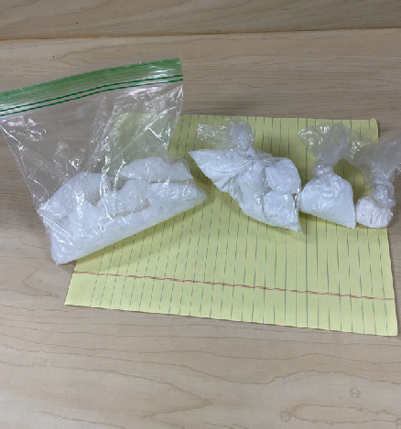
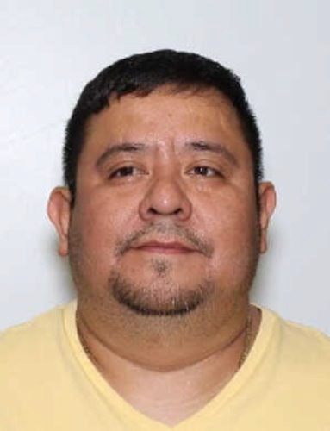
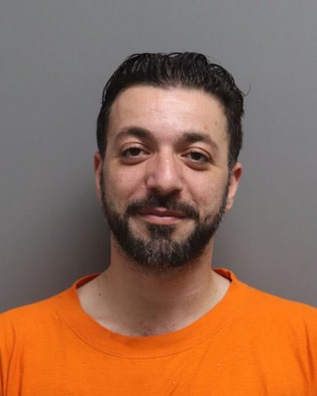
South Carolina State Grand Jury
Last Stand

Slide 2
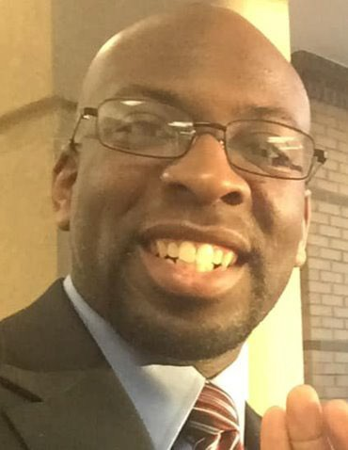
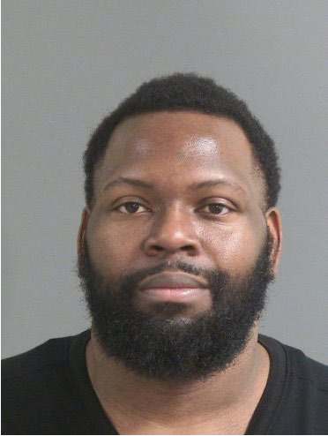
Rami Abuhani
Juan Balderas-Cerritos
Timothy Christian Brown
Lorenzo Johnson
Trafficking Cocaine 400 Grams or More (Conspiracy)
Trafficking Cocaine Trafficking Cocaine
Trafficking Cocaine 400 Grams or More (Conspiracy)
400 Grams or More 400 Grams or More (Conspiracy) (Conspiracy)

Slide 3
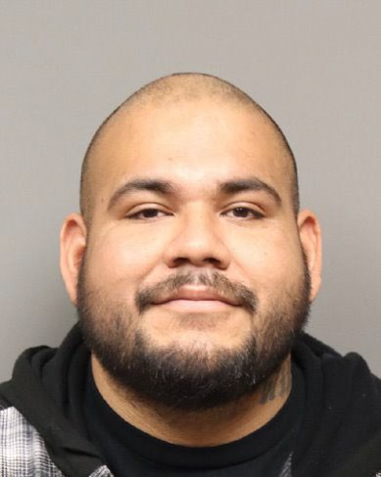
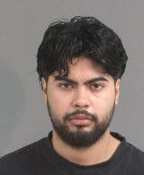
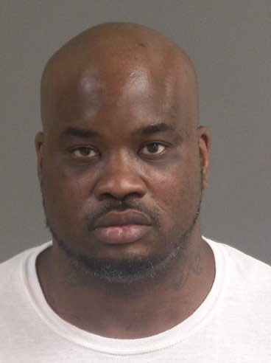
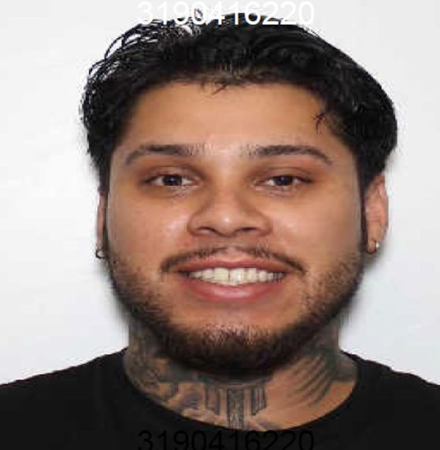
Pedro Moreno
Reynaldo Lopez
Rickey Omar Swinton
Manuel Gutierrez
Trafficking Cocaine 400 Grams or More (Conspiracy)
Trafficking Cocaine Trafficking Cocaine
Trafficking Cocaine 400 Grams or More (Conspiracy); Possession of a Stolen Handgun
400 Grams or More 400 Grams or More (Conspiracy) (Conspiracy)

Slide 4
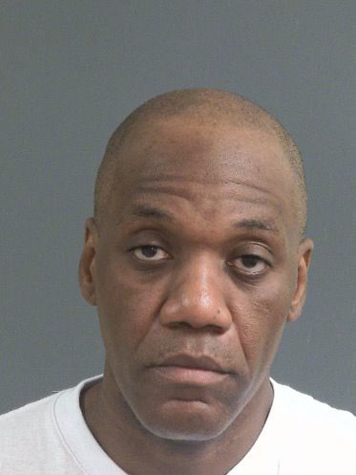
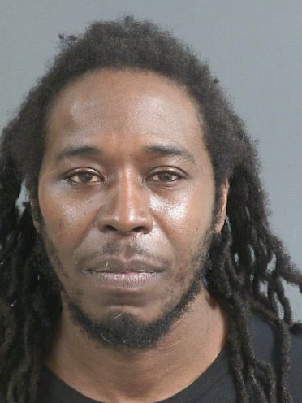
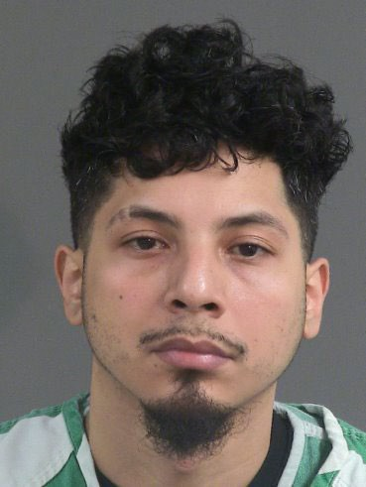
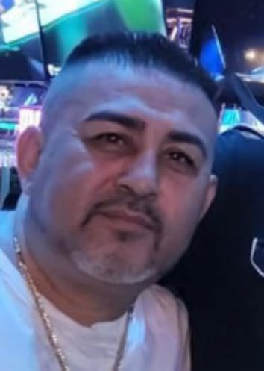
Ramon William Green
Ramon Gamble
Oscar Orlando Sierra Jr
Jose Carreno Rodriguez
Trafficking Cocaine 400 Grams or More (Conspiracy)
Trafficking Cocaine Trafficking Cocaine
Trafficking Cocaine 400 Grams or More (Conspiracy); Possession of a Stolen Handgun
400 Grams or More 400 Grams or More (Conspiracy) (Conspiracy)

Slide 5
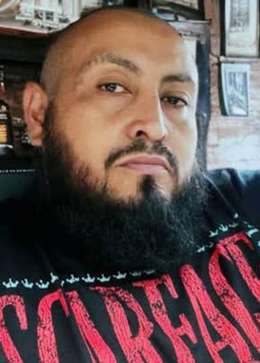
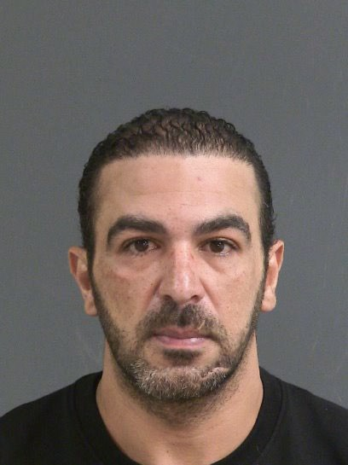
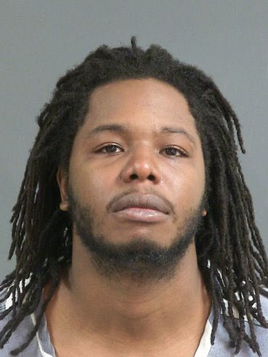
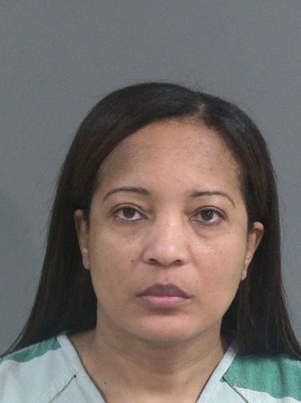
Jose Rodriguez Campos
Ahmed Adel Elallawy
Nykeil Miller
Arelis Del Carmen Santos Gomez
Trafficking Cocaine 400 Grams or More (Conspiracy)
Trafficking Cocaine Trafficking Cocaine
Trafficking Cocaine 400 Grams or More (Conspiracy);
Drug/Violation Drug Distribution Laws; Prostitution/Operating a Brothel x2; Prostitution/Further Unlawful Acts x2
400 Grams or More 400 Grams or More (Conspiracy) (Conspiracy)

Slide 6
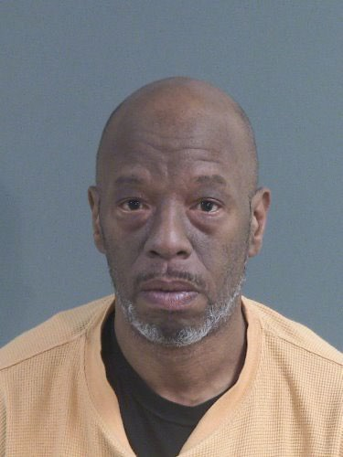
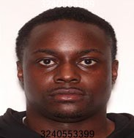
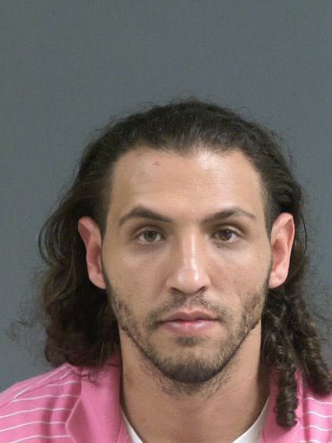
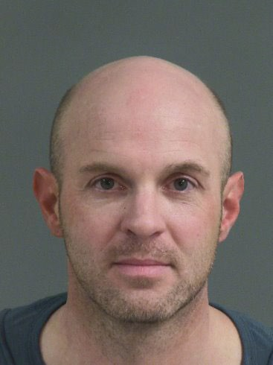
Mark Christopher Casey
Abraham Doctor IV
Zakaria Ahmad Quzah
Christopher Best
Trafficking Cocaine 400 Grams or More (Conspiracy); Possession of Cocaine
Trafficking Cocaine Trafficking Cocaine
Trafficking Cocaine 400 Grams or More (Conspiracy);
PWID Cocaine;
Pointing Firearm at another Person; Possession of Marijuana
400 Grams or More 400 Grams or More
(Conspiracy); Trafficking Cocaine, 28-100 Grams
(Conspiracy)

Slide 7
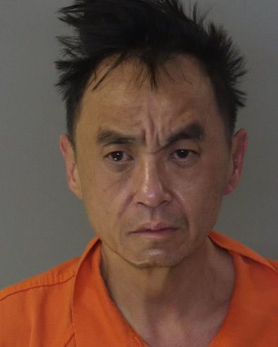
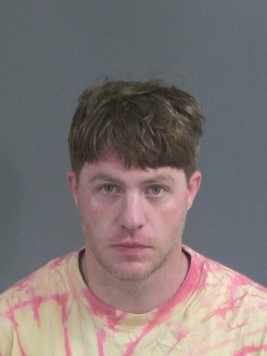
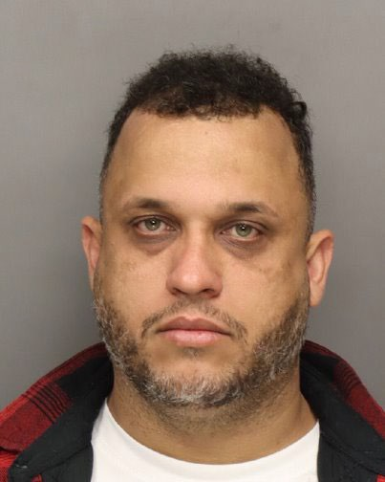
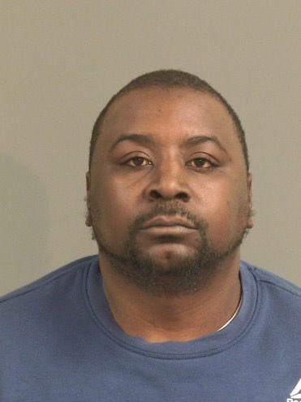
Richard Pham
Evan Cole
Angel Castillo Menendez
Demaro Rollison
Trafficking Cocaine 400 Grams or More (Conspiracy);
Trafficking Cocaine, 10 -28 Grams; Distribution of Methamphetamine; Trafficking Cocaine, 28-100 Grams; Trafficking Fentanyl;
PWID Fentanyl
Trafficking Cocaine Trafficking Cocaine
Trafficking Cocaine Base, 10-28 Grams; PWID Cocaine;
PWID Marijuana; Possession of a Firearm During Commission of or Attempt to
Commit a Violent Crime
400 Grams or More 400 Grams or More
(Conspiracy); Trafficking Cocaine, 28-100 Grams;
Possession of Contraband in County Jail
(Conspiracy)

Slide 8
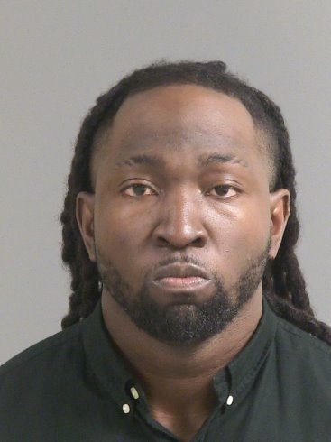
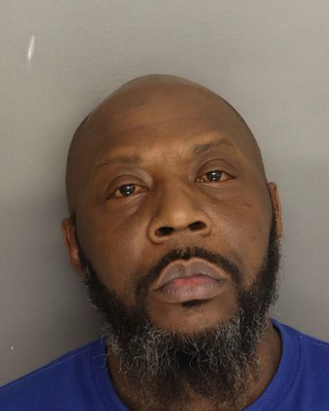
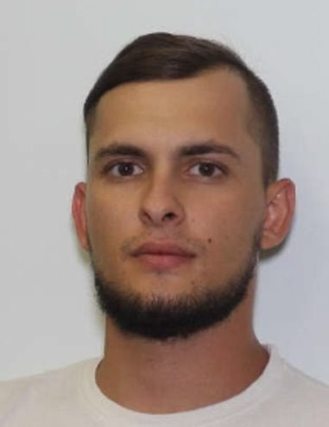
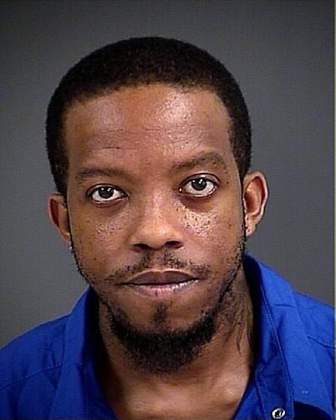
Branden Antwan Ferrell
Antonio Levy
David Slavi Ivanov
Eric Deangelo McKenzie
Trafficking Cocaine 400 Grams or More (Conspiracy)
Trafficking Cocaine Trafficking Cocaine
Trafficking Cocaine 400 Grams or More (Conspiracy)
400 Grams or More 400 Grams or More (Conspiracy) (Conspiracy)

Slide 9
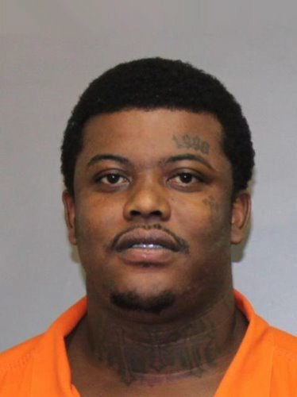
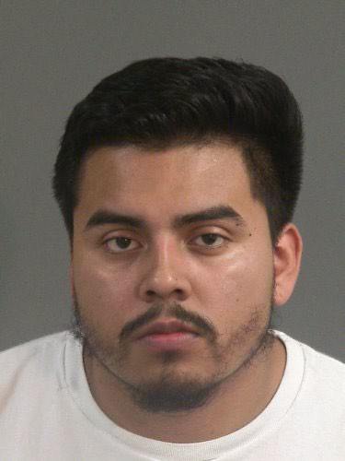
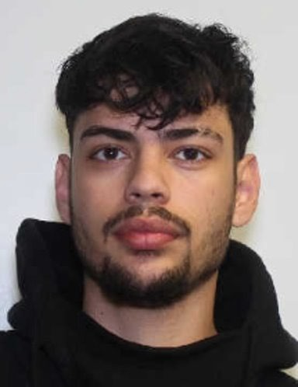
Jed Hakeem Coleman
Juan Carlos Velazquez Morales
Juan Diego Bohorquez Quast
Trafficking Cocaine 400 Grams or More (Conspiracy);
Possession of Methamphetamine; Failure to Stop for Blue Lights; Resisting Arrest
Trafficking Cocaine
400 Grams or More
(Conspiracy)
Trafficking Cocaine 400 Grams or More (Conspiracy)

Slide 10
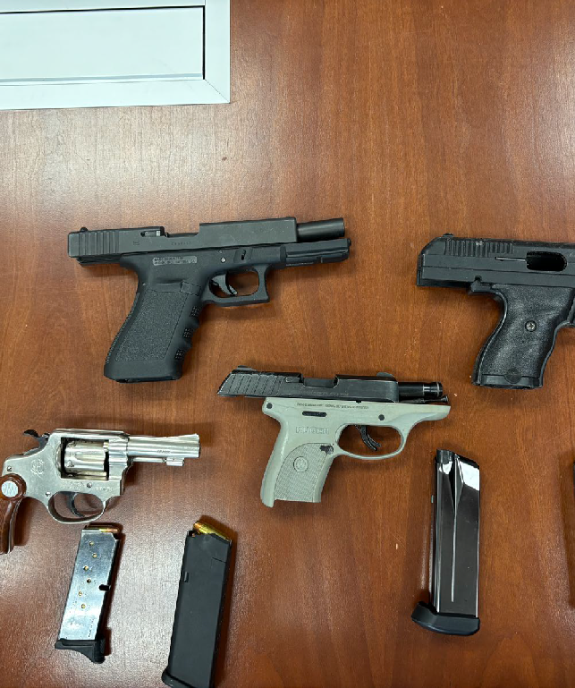

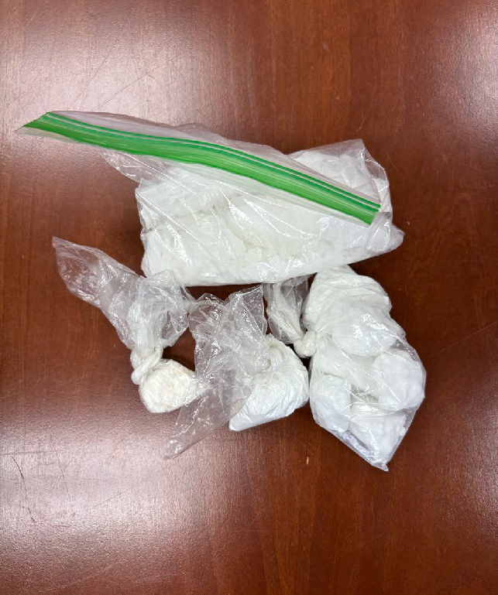
Operation: Last Stand
10

Slide 11

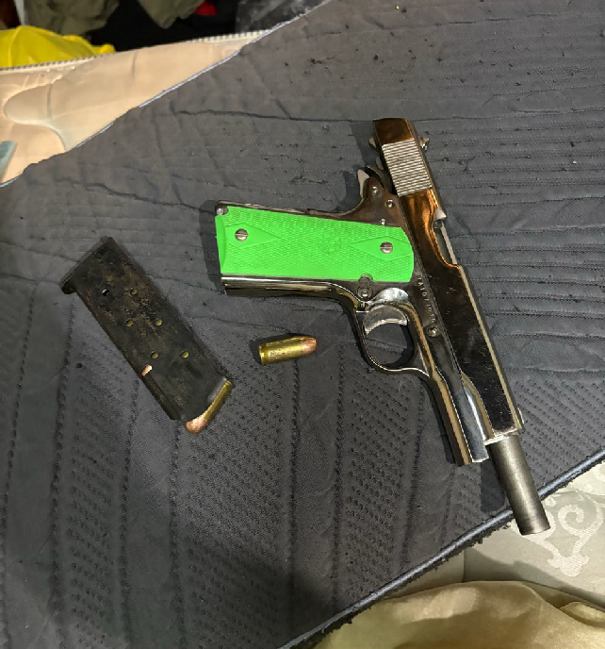
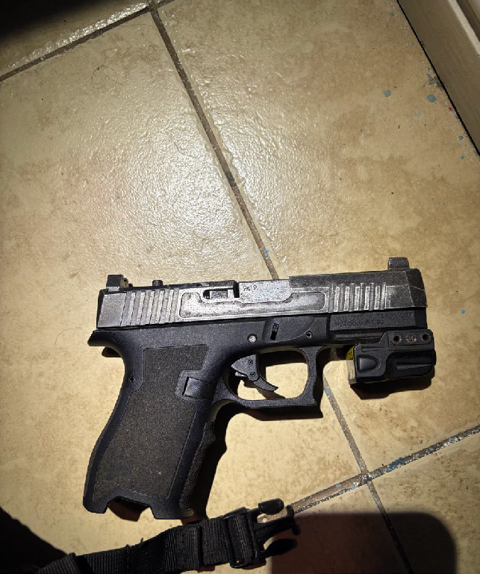
Operation: Last Stand
11

Slide 12
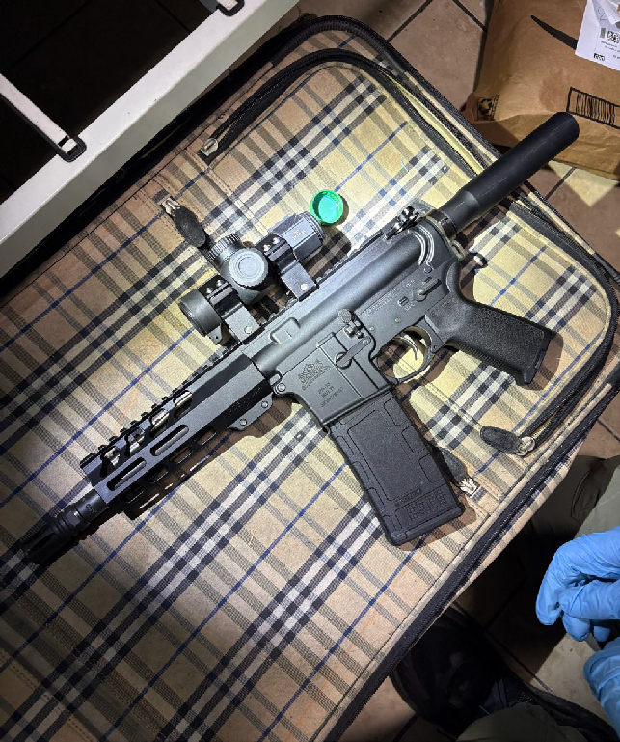
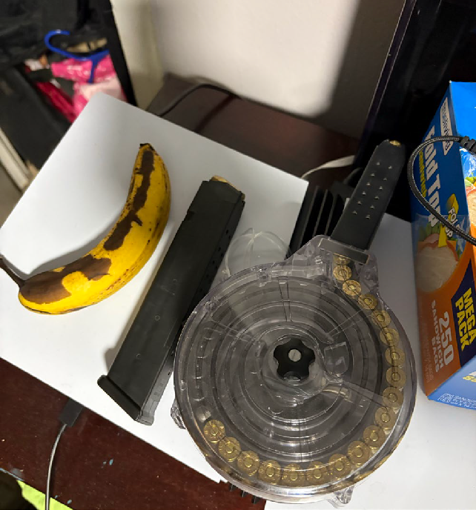
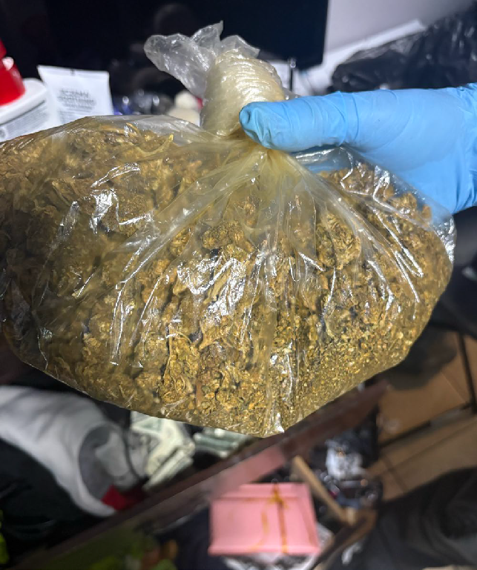
Operation: Last Stand
12

Slide 13
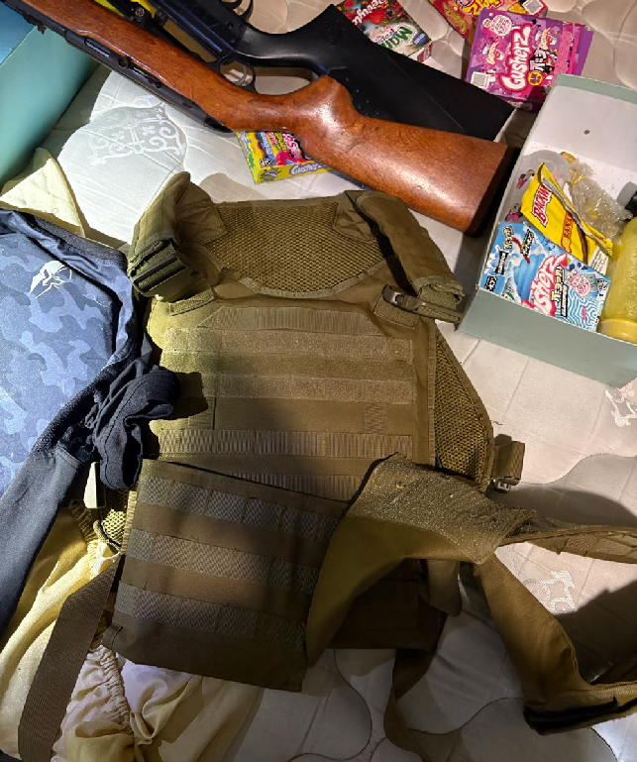
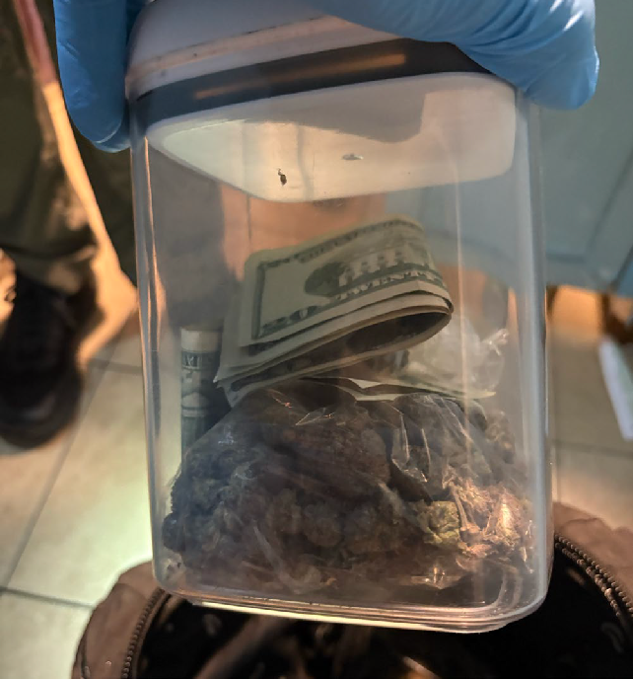
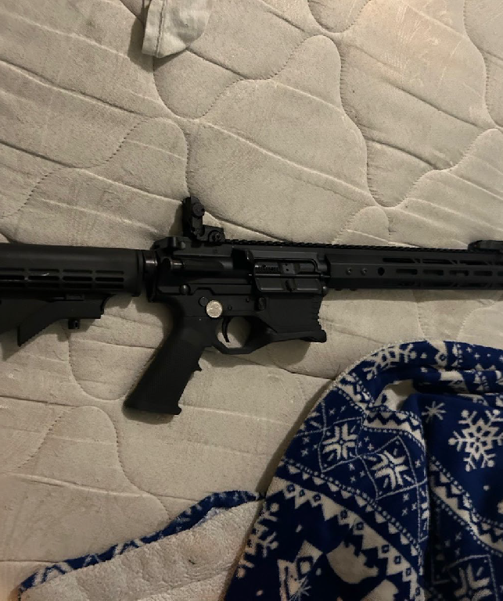
Operation: Last Stand
13

Slide 14
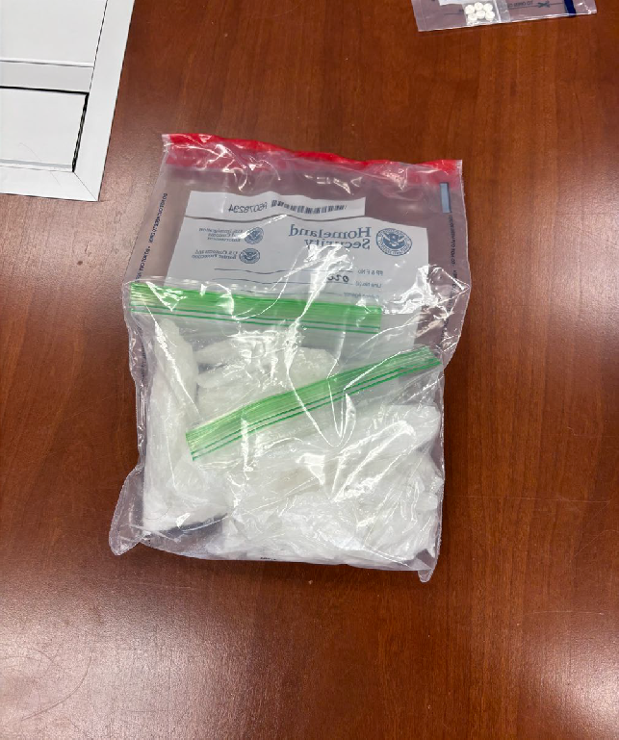
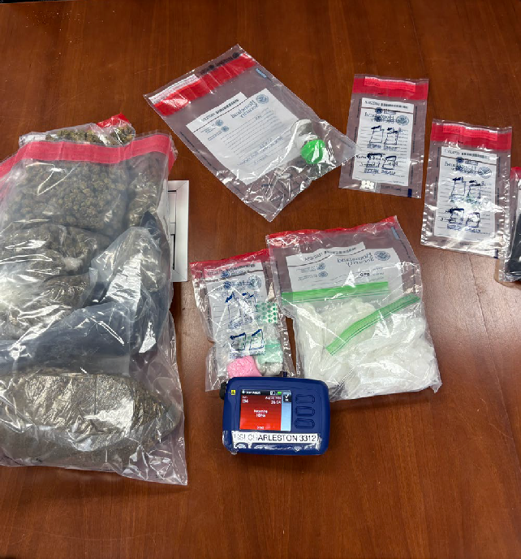
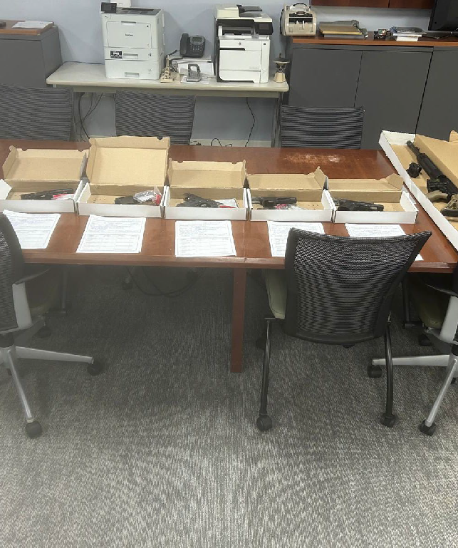
Operation: Last Stand
14

Slide 15
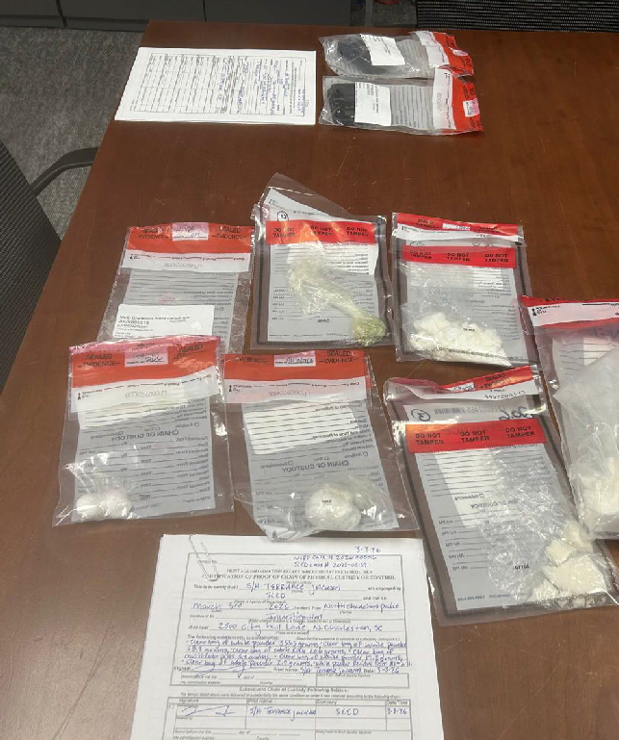

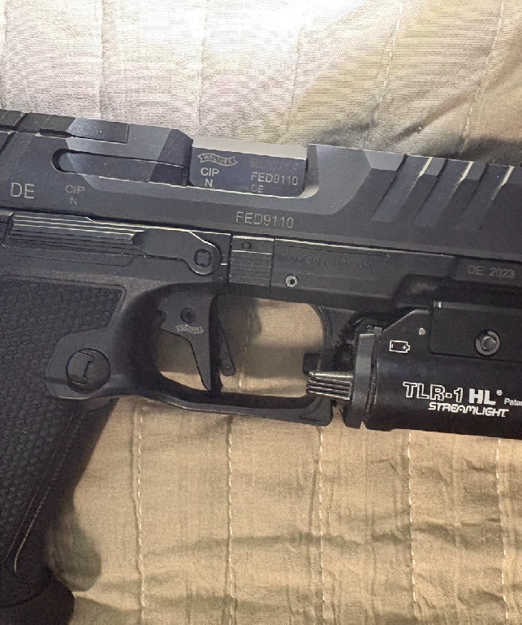
Operation: Last Stand
15

Slide 16
