Slide 1


Law Enforcement
Victim Service Providers
First Responders Changing Lives

Slide 2
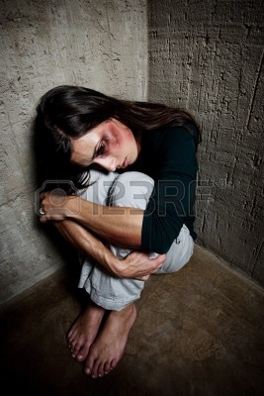
Definition of Victim:
S.C. Code Section 16-3-1510
An individual who suffers
    Direct or threatened
    physical
    psychological or
    financial harm
as a result of the commission or attempted commission of a crime.
Victim also includes
  victim’s spouse, parent or child
  lawful representative a victim who
  - deceased
  - a minor
  - incompetent
  - physically or
  - psychologically incapacitated

Slide 3

Who is not a crime victim?
S.C. Code Section 16-3-1510. Definitions.
Victim DOES NOT INCLUDE any individual
who is the subject of the investigation
who is charged with the offense in question
who has been convicted, pled guilty or nolo contendre to the offense in question
who is the spouse, parent, child or lawful representative acting on behalf of the suspect
who was imprisoned or engaged in an illegal act at the time of the offense

Slide 4
SOUTH CAROLINA CONSTITUTION
ARTICLE I.
SECTION 24. Victims’ Bill of Rights.
(A) To preserve and protect victims’ rights to justice and due process regardless of race, sex, age, religion, or economic status, victims of crime have the right to:
(1) be treated with fairness, respect, and dignity, and to be free from intimidation, harassment, or abuse, throughout the criminal and juvenile justice process, and informed of the victim’s constitutional rights, provided by statute;
(2) be reasonably informed when the accused or convicted person is arrested, released from custody, or has escaped;
(3) be informed of and present at any criminal proceedings which are dispositive of the charges where the defendant has the right to be present;
(4) be reasonably informed of and be allowed to submit either a written or oral statement at all hearings affecting bond or bail;
(5) be heard at any proceeding involving a post‑arrest release decision, a plea, or sentencing;
(6) be reasonably protected from the accused or persons acting on his behalf throughout the criminal justice process;

Slide 5
SOUTH CAROLINA CONSTITUTION (cont’d)
(7) confer with the prosecution, after the crime against the victim has been charged, before the trial or before any disposition and informed of the disposition;
(8) have reasonable access after the conclusion of the criminal investigation to all documents relating to the crime against the victim before trial;
(9) receive prompt and full restitution from the person or persons convicted of the criminal conduct that caused the victim’s loss or injury, including both adult and juvenile offenders;
(10) be informed of any proceeding when any post‑conviction action is being considered, and be present at any post‑conviction hearing involving a post‑conviction release decision;
(11) a reasonable disposition and prompt and final conclusion of the case;
(12) have all rules governing criminal procedure and the admissibility of evidence in all criminal proceedings protect victims’ rights and have these rules subject to amendment or repeal by the legislature to ensure protection of these rights.

Slide 6
Victim Service Provider (VSP)
S.C. Code Section 16-3-1400. Definition.
For purposes of this article:
(1) “Victim Service Provider” means a person:
    Who is employed by a local government or state agency and whose job duties involve providing victim assistance as mandated by South Carolina law or
    Whose job duties involve providing direct services to victims and who is employed by and organization that is incorporated in South Carolina, holds a certificate of authority in South Carolina, or is registered as a charitable organization in South Carolina, and the organization’s mission is victim assistance or advocacy and the organization is privately funded or receives funds from federal, state, or local governments to provide services to victims.
    Victim Service Provider does not include a municipal court judge, magistrates court judge, circuit court judge, special circuit court judge, or family court judge.

Slide 7
Victim Service Providers
Training Requirements
S.C. Code Ann. Section 16-3-1620(D), public victim assistance programs shall ensure that all victim service providers employed in their respective offices are certified through the Office of Victim Services Education and Certification (OVSEC) within the Crime Victims’ Ombudsman.
VSP Training
Kim Hamm
803-734-0794
Khamm@scag.gov

Slide 8
TWO TYPES OF VICTIM ASSISTANCE SPECIALISTS
1. VSPs, LEVAs - Liaison
Training/ Certification Requirements:
Year 1: 15 hours of training:
1. SC Victims' Rights/Compliance/Statutes
3 hours
2. Compensation Fund/SOVA
1 hour
3. Ethics/Confidentiality
2 hours
4. Criminal Justice System/Court Procedures
2 hours
5. Case Management
2 hours
6. Communication
2 hours
7. Specialized Training
3 hours
Continuing Education Requirements:
12 hours of training Annually
2. NOTIFIERS
Notifiers work in courts and jails/detention centers and are mandated to notify crime victims about hearings and trials, and offenders’ releases, transfers and/or escapes.
Training/ Cert. Requirements:
2 hours of Victims’ Rights training every other year
SC Code Ann. Section 16-3-1620(D)

Slide 9


Law Enforcement’s Duties to Victims
Upon Commission of Crime:
SC Code Section 16-3-1520 (A) LAW ENFORCEMENT (LE)
  MUST provide a free copy of the incident report to the victim and a victim’s rights document which
  Describes a victim's constitutional rights
  Describes responsibilities of victims to exercise their rights
  Lists local victim assistance and social service providers
  Provides information on eligibility and application victims compensation benefits
  Provides information about rights of victims and witnesses who are harassed or threatened

Slide 10
LAW ENFORCEMENT’S MANDATORY SERVICES
TO CRIME VICTIMS
SC Code Section 16-3-1520 (B) LEVA
Within a reasonable time of initial contact :
    MUST assist each eligible victim in applying for
    Compensation and other
          Financial,
              Social Service, and
                Counseling assistance.

Slide 11
Victims' Compensation Fund
DCVC can help with crime related expenses:
Medical Costs
Dental / orthodontic work
Physical rehabilitation Reconstructive surgery
EMS/ Ambulance
Counseling (from a licensed professional)
Funeral/ Burial Expenses
Lost Wages / Loss of Support
Up to two-thirds of average weekly wages
Dept. of Crime Victim Compensation (DCVC)
803-734-1900
http://www.sova.sc.gov/
(application online)

Slide 12
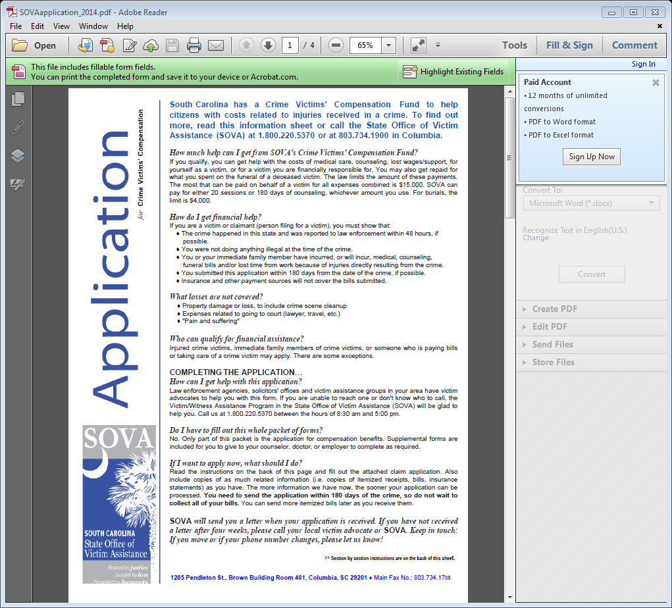

Slide 13
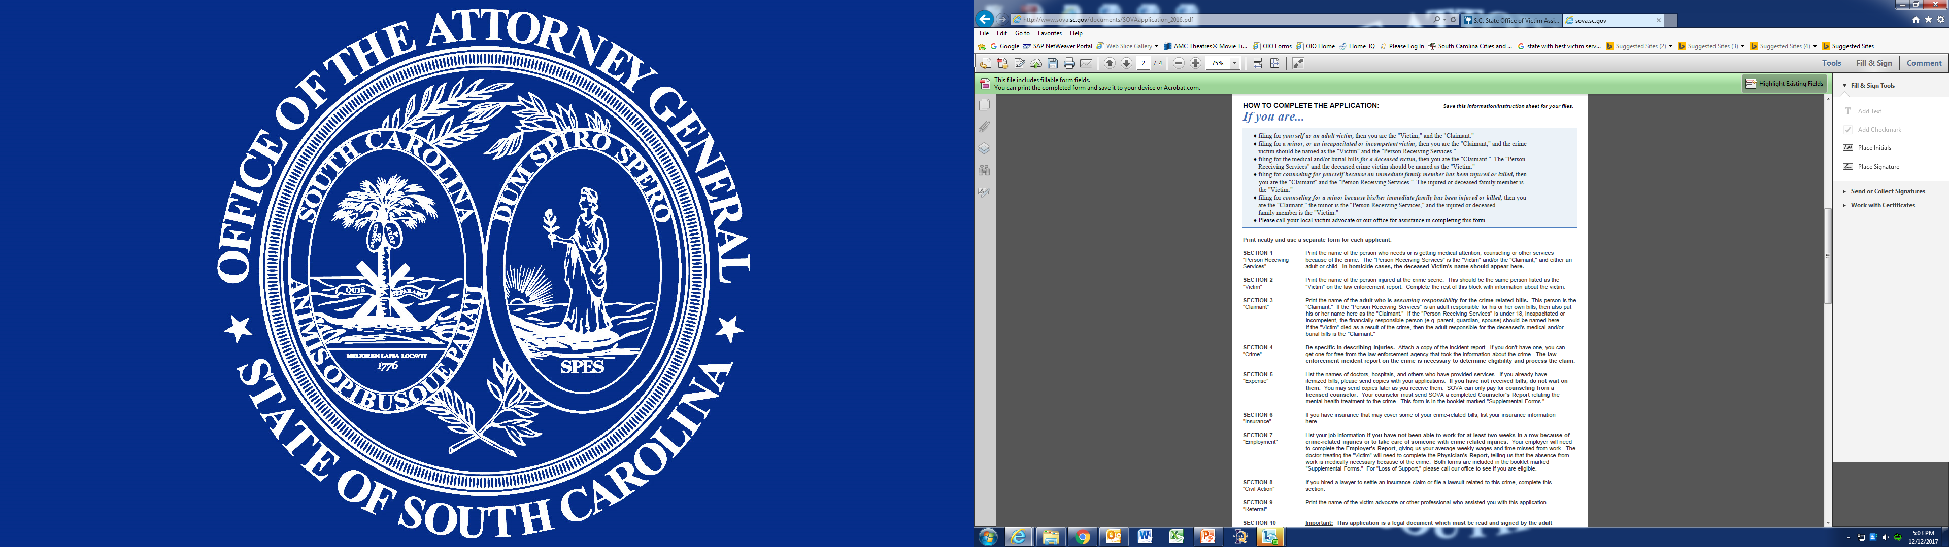

Slide 14
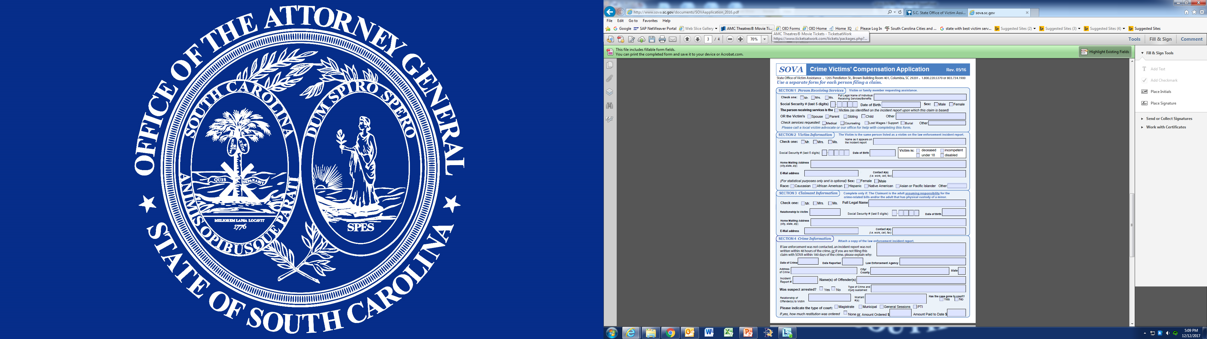

Slide 15
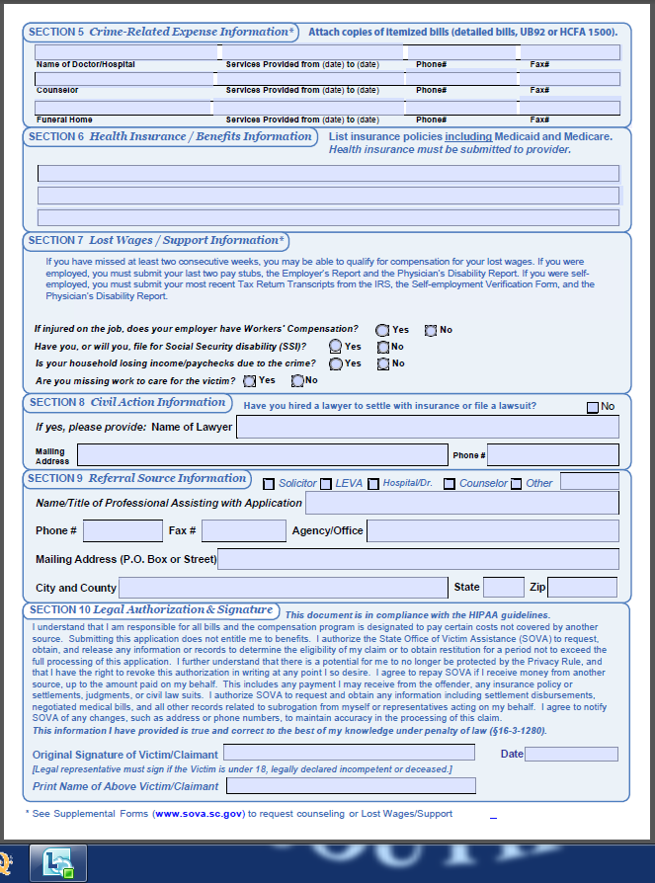

Slide 16
LAW ENFORCEMENT’S MANDATORY SERVICES
TO CRIME VICTIMS
    Other financial, social service, and counseling assistance
FINANCIAL ASSISTANCE AVAILABLE:
SC Victim Assistance Network (SCVAN)
803-750-1200 ext. 155
www.SCVAN.org
- Crime Scene Clean-up - Medicine
- Food - Glasses
- Locks, Doors, Windows - Clothing
Transportation to Safety - Teeth
Hotel stays (arson, DV) - Diapers,formula

Slide 17
SOCIAL SERVICES
Get to know your Community Partners!
Google your Local Providers!
211
Translators
Food banks
Local Sexual Assault Center
Local DV Shelter
Local Churches (food, clothing, support groups)
Homicide Support Groups
Red Cross (arson)
LAW ENFORCEMENT’S MANDATORY SERVICES
TO CRIME VICTIMS

Slide 18
LAW ENFORCEMENT’S MANDATORY SERVICES
TO CRIME VICTIMS
COUNSELING
Trauma-trained therapists – Identify your local therapists!
Google “Project Best MUSC”: Statewide Roster of trauma-trained therapists (NOT all therapists are on this list!)
http://academicdepartments.musc.edu/projectbest/roster/roster.htm

Slide 19
  SC Code Section 16-3-1520 (C) LEVA
    Intervene on behalf of victims with creditors, employers, schools, landlords;
  SC Code Section 16-3-1520 (D) LEVA
    Inform victim of status and progress of case and investigation through disposition in summary court; referral to the Department of Juvenile Justice or through final transmittal of general sessions warrant to the prosecutor.
LAW ENFORCEMENT’S MANDATORY SERVICES
TO CRIME VICTIMS

Slide 20
Law Enforcement Agency Responsibilities to Victims Upon Arrest of Suspect:
    SC Code Section 16-3-1525 (A) LEVA and Notifier
  upon arrest or pick-up, must notify the victim of the arrest, detention and bond hearing, or other pretrial hearings;
  SC Code Section 16-3-1525 (B) Notifier
  must make a reasonable attempt to notify each victim before releasing a juvenile to his parent or guardian;
  SC Code Section 16-3-1525 (C) LEVA/LE
  must provide the name, mailing address and telephone number of each victim to the jail, prison, or detention of holding facility;
  SC Code Section 16-3-1525 (D) LE/ Notifier
  must provide the name, mailing address and telephone number of each victim to the Department of Juvenile Justice with the juvenile offender;
  SC Code Section 16-3-1525 (E) LE/ Notifier
  must provide, in writing, the name, mailing address and telephone number of each victim to the prosecuting agency for any offense triable in circuit court;
  SC Code Section 16-3-1525 (F) LE/Notifier
  must provide, in writing, the name, mailing address and telephone number of each victim to the court for any offense triable in summary court; and,

Slide 21
    SC Code Section 16-3-1525 (G) LE
    Protect victims and witnesses by any measures necessary, including transportation to and from court and protection at court.
  SC Code Section 16-3-1535 (E) LE
  Return to victim any personal property recovered or taken as evidence as expeditiously as possible; substituting photographs for evidence when possible.
    SC Code Section 16-3-1550 (C) LE
    Must make reasonable efforts to provide separate waiting areas for victims from defendants for proceedings in circuit and family courts.

Slide 22
In addition to the minimums set by State Law, MOST SC Law Enforcement Victim Advocates:
  Engage EARLY in the process
  Provide emotional and moral support
  Conduct immediate on-scene crisis counseling
  Assist in obtaining Orders of Protection (from Family Court, for victims of domestic violence)
  Assist in obtaining Restraining Orders (from Magistrates, for victims of stalking and harassment)
  Assist in obtaining emergency housing
  Assist Elder Abuse victims, people with disabilities
  Participate in interviews and forensic examinations
How Do LEVAs Operate Across the State?

Slide 23
Attorney General’s Office
Statewide Sexual Assault Protocol
January, 2014
P. 42-43
LEVA may Respond to Crime Scene
Dispatch / first responders/ investigator alerts LEVA
LEVA will be briefed
LEVA will ensure victim’s immediate safety
Offer emotional and practical support
Contact friends or family members
Determine special needs (translator /deaf/ elderly/ disabled) and locate special services
Provide privacy at the scene
Assure victim that LE is there to help
Remain during initial interview
Remind victim not to wash, explain that LE will collect clothing and other items.
Advise victims of proper procedures re evidence collection
Explain the LE process: What Officers are doing and Why.
Confirm that EMS has been called in the event of major injuries.
May transport victim to the hospital for forensic exam.

Slide 24
Attorney General’s Office
Statewide Sexual Assault Protocol
January, 2014
B. The LEVA may respond to the hospital:
LEVA will be briefed by officer/investigator.
Confirm that SANE/FNE and sexual assault advocate have been notified.
Offer preliminary Victims’ Rights information.
Provide support with victim until forensic examiner/sexual assault advocate arrive.
Assist in contacting family, friends if requested.
In All Sexual Assault cases, the LEVA will:
Inform victim of options for Orders of Protection and Restraining Orders.
Address safety measures.
Refer to appropriate psychological and social services.
Explain the Victim Compensation Program and apply if needed (always covers cost of forensic exam).

Slide 25
TYPES OF CRIME VICTIM STATS (STATE OFFICE OF VICTIM ASSISTANCE AUDITS)
TYPE OF VICTIMIZATION | Glynn Municipal | Wayne Municipal | Duvall Municipal
ASSAULT/THREATS | 2 | 5 | 1
AB/ABHAN | 39 | 24 | 15
CDV/CDVHAN | 36 | 46 | 30
CSC | 0 | 1 | 0
CSC W/MINOR | 0 | 3 | 1
CONTRIBUTING TO A MINOR | 4 | 0 | 0
DEATH | 0 | 0 | 1
ARSON | 0 | 5 | 2
HARASSMENT/STALKING | 8 | 6 | 6
HOMICIDES | 0 | 0 | 0
PROPERTY CRIMES | 11 | 3 | 2
ROBBERY | 3 | 3 | 0
ALL OTHER CRIMES | 8 | 9 | 1
TOTAL: | 111 | 105 | 59

Slide 26
MO. SERVICES PROVIDED / VSPs (STATE OFFICE OF VICTIM ASSISTANCE AUDITS)
TYPE OF SERVICES PROVIDED | Glynn Municipal | Wayne Municipal | Duvall Municipal
ACCOMPANIMENT TO COURT | 70 | 66 | 42
CASE INFORMATION | 101 | 131 | 56
CRIME SCENE CLEAN UP INFO. | 0 | 0 | 0
CRIMINAL JUSTICE INFORMATION | 68 | 75 | 32
COMPENSATION - INFO/FILING/F-UP | 12 | 4 | 0
LETTERS OF ASSISTANCE | 45 | 54 | 16
MEDICAL RECORDS - REQ/FORWARD | 0 | 0 | 0
PHOTO TAKEN | 3 | 4 | 0
REFERRALS TO – DV /SARC/CFEJ (legal) | 22 | 25 | 5
RO/OOP INFO/FILING/TRE.LETTER | 34 | 7 | 2
SAFETY PLAN | 1 | 1 | 0
SCHEDULE CSE EXAM | 0 | 0 | 0
SCVAN EMERGENCY FUNDS | 1 | 0 | 0
STATEMENT TAKEN/TAPE REQUEST | 0 | 0 | 0
TRANSPORT | 0 | 0 | 0
OTHER (VM & Email) | 26 | 10 | 0
TOTAL: | 383 | 377 | 153

Slide 27
8. Postage, copying and printing cost for programs as relating to notification services and correspondence relating to direct victim services as carried out by the Victim Service Provider
9. Brochures for crime victims describing the crime victim services available through the entities and contact information. Reference materials.
10. Telephone charges relating directly to crime victim services;
11. Pager, cell phone expenses for personnel providing direct crime victim services;
12. Volunteer personnel and training expenses directly providing services to crime victims;
13. Office supplies for personnel directly involved in providing services for crime victims;
14. Camera, film, video tape, VCR recording equipment to support evidence documentation for domestic violence and sexual assault cases and viewing of educational materials for victims;
15. Recording or translation services directly related to crime victim services;
Approved Guide for Expenditures of Monies Collected for Crime Victim Service in Municipalities and Counties
Effective December / 2013
The following is a list of approved expenditures of crime victims’ funds retained by county and municipal governments pursuant to Sections 14-1-206, 14-1-207,14-1-208, and 14-1-211 exclusively for the purpose of providing victim services; including but not limited to:
1. Personnel, salaries/ benefits, performing direct services to crime victims (Victim Advocates within law enforcement and solicitor offices, notifiers for detention centers and the summary courts);
2. Automobiles shall be used solely by the Victim Service Provider (VSP) for providing direct victim services for the life of the automobile.
3. Expenses for a victim may be reimbursed to the Victim Service Provider (VSP) only while providing direct victims services at the rate of per diem for meals and transportation
4. Computers, computer software, internet connection, website for personnel providing direct crime victim services;
5. Automated victim information and notification systems; (SAVIN)
6. Training and conference registration, hotel accommodations for personnel providing direct crime victim services;
7. Office space, furniture, equipment (telephone, telephone lines, 800 numbers, fax, copier) and equipment maintenance for personnel providing direct crime victim services;

Slide 28

QUESTIONS?
Call me!
Veronica Swain Kunz
Crime Victim Ombudsman
803.734.0357 (office)
VKunz@SCAG.gov (Email)
www.CVO.SC.Gov (website)

